Slide 1
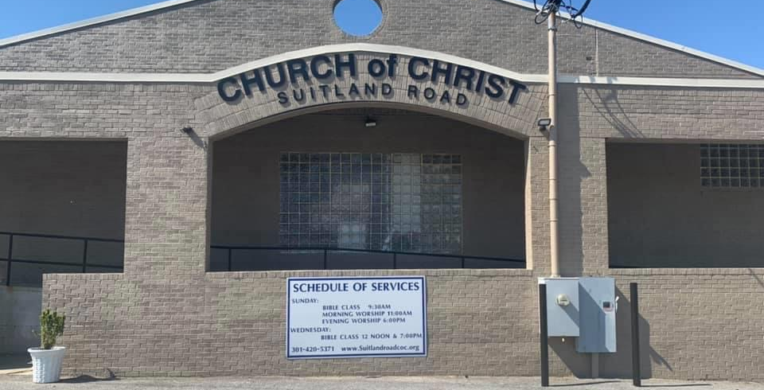

Slide 2
Suitland Road Church of Christ
Congregational Zoom Meeting
Wednesday, September 23, 2020 @7 PM

Slide 3
Message from the leadership
The State of Maryland has lifted some of the restrictions for gatherings. We are all aware that these are challenging times this virus continues to spread. We have carefully researched, planned and implemented various safety protocols and practices to ensure a healthy and safe return to Worship Service at the building. We will continue to adhere to safe and healthy practices for all. We will continue to monitor and track the CDC, State of Maryland, and news regarding the COVID-19 virus. We are committed to make the necessary changes and adjustments. We pray that as members of the congregation we will all work together in love as we adjust to these new protocols and practices.
Thank you

Slide 4
Reopening plans
DATE
SUNDAY, OCTOBER 4, 2020 SUNDAY MORNING WORSHIP SERVICE
11:00 AM

Slide 5
Reopening plans
PART 1 BUILDING READINESS
Sanctuary set up for social distancing including directional signage
A/V setup for sound and streaming
Signs posted for entry and exit.
Mask and social distancing signage posted around building
Hand sanitizer stations set up
Volunteers will be solicited to work check-in table.
Training Session will be held on the Saturday prior to re-opening.

Slide 6
Reopening plans
PART 11 ENTRY AND EXIT LOGISTICS
The Leadership encourages all members who are in the high-risk category (elderly and people with certain underlying medical conditions) not to physically attend worship service at the time of re-opening.
Live-stream Sunday Morning Worship Service will continue via Facebook Live.

Slide 7
Reopening plans
PART 11 ENTRY AND EXIT LOGISTICS
All members and guest will be encouraged to park across the street in the overflow parking lot.
Exceptions will be made for elderly members, members with a disability and members with small children to park in the back lot.
Brothers will be assigned to assist guest and members to cross the street
The parking lot will be monitored by attendants.
The parking lot behind the building will be used for essential staff assigned to work on the logistics of the building entry.
Sanitation table and tent will be set-up at the bottom of the handicap ramp.
Temperatures check will be required for all members and guest. All results will be logged into a secured notebook.
Member/guest will be required to initial/sign their entry in the secured notebook.

Slide 8
Reopening plans
PART 11 ENTRY AND EXIT LOGISTICS
Hand sanitizer will be required upon entrance into the building
Communion will be distributed at this location.
Everyone entering the building will be required to wear a mask.
Mask will be available for individuals who do not have a mask or did not bring their mask.
No building entry without mask
Entry into the building will be up the ramp and through the double doors. This will only be used for entrance into the building.
At the beginning of service, members/guest will not be allowed to exit through the front door entrance into the building. They must exit the building through the fellowship hall.
At the end of service, everyone will be allowed to exit through the front door as no one will be entering the building.

Slide 9
Reopening plans
Part III: Time and Attendance
Sunday School via Zoom from 9am-9:45am which will allow travel time to Worship Service at the church building.
(PLEASE NOTE TIME CHANGE)
Worship Service at 11am.
Volunteer workers should arrive by 10am for temperature check-in.
Temperature check and communion pick-up - 10:15am -10:50am.
Entrance doors will be secured at 11am.
On-time arrival will be encouraged due to logistics and not
to disturb Worship Service.

Slide 10
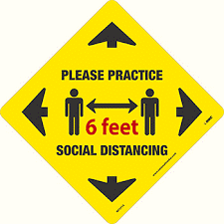
We require ALL members and guest to following the Safety Protocols Below. These protocols will help to ensure our safe & healthy return to the church building.
1.
2.
3.

Slide 11
SRCOC ON-LINE ZOOM CLASSES
(WEEKLY/MONTHLY) | ONLINE ZOOM BIBLE | TEACHERS
Sunday Morning - Adults 9:30 AM | Study-Book of Ephesians | L. Johnson, 240-691-9239
Sunday Morning-Youth 9:30 AM | Fundamentals of the Faith Children | Jaumale Sykes, 240-353-0713
Monday Evenings 7-8:15 PM | Fundamentals of the Faith Adults | Eric Sykes, 240-603-7070
Tuesday Evenings 7 – 8:00 PM | Ladies Bible Study – Worship | Evelyn Redic, 301-751-2447
Wednesday Evenings – Adults 7 PM | Study – Book of Ephesians | L. Johnson, 240-691-9239
Thursday Evenings – New Converts | Christian Evidences – 6 PM | Eric Sykes, 240-603-7070
Thursday Evenings – Youth 7 PM | Christian Evidences | Jaumale Sykes, 240-353-0713
Friday Evenings 7-8:15 PM | Denominational Doctrines | Eric Sykes, 240-603-7070
Saturday: Oct 17, 2020 –11:00 AM | Ladies Ministry Monthly Class | Sandy Sykes, 240-871-7142
Friday Evening: Oct 23, 2020 - 7:00 PM | Men’s Business Meeting | James Redic 240-691-9237 Bill Davis 240-691-9238
SRCOC PRAYER CALL: Monday – Saturday at 9:30 A.M. To join the call: Dial: 805-309-2350 and enter ID 4331113#

Slide 12
Please feel free to ask any questions or express any concerns!
Thank you
Suitland Road Church of Christ Leadership Team

